Slide 1
Plate Design
ME 313: Mechanical Design
Week 5

Slide 2
Definition of Plate
A flat component that takes the load on its surface
The main mechanism of load resistance is bending

Slide 3
Plate Governing Equation
Much like beam bending, plate bending also has a governing equation
where v (English letter v) is the deflection, P is the load, and D is the bending rigidity of plate
where E is the modulus of elasticity, t is the thickness of the plate, and ν (Greek letter nu) is the Poisson’s ratio

Slide 4
Plate Deflection Under Loads
Deflection depends on various things
Plate shape: circular or rectangular
Boundary conditions: fixed (clamped) or simple support
We will go through the equations for plate deflections for each case

Slide 5
Circular Plate with Uniform Load
Clamped edges
Maximum deflection
Maximum stress
where q is the magnitude of load per area (pressure)
q
a

Slide 6
Circular Plate with Uniform Load
Simply supported edges
Maximum deflection
Maximum stress
q
a

Slide 7
Circular Plate Loaded at the Center
Clamped edges
Maximum deflection
Simply supported edges
P
a

Slide 8
Rectangular Plate under Uniform Loading
Clamped edges
Maximum deflection
q
a
b
b/a | α
1.0 | 0.00126
1.5 | 0.00220
2.0 | 0.00254

Slide 9
Rectangular Plate under Uniform Loading
q
Clamped edges
Maximum stress can be calculated from bending moment
There are bending moments both in x and y directions
a
b
b/a | β_{x} | β_{y}
1.0 | -0.0513 | -0.0513
1.5 | -0.0757 | -0.0570
2.0 | -0.0829 | -0.0571
Notes:
Maximum stresses occurs along the edges

Slide 10
Rectangular Plate under Uniform Loading
Simply supported edges
Maximum deflection
q
a
b
b/a | α
1.0 | 0.00406
1.5 | 0.00772
2.0 | 0.01013

Slide 11
Rectangular Plate under Uniform Loading
q
Simply supported edges
Maximum stress can be calculated from bending moment
There are bending moment both in x and y directions
a
b
b/a | β_{x} | β_{y}
1.0 | 0.0479 | 0.0479
1.5 | 0.0812 | 0.0498
2.0 | 0.1017 | 0.0464
Notes:
Maximum stresses occurs at the center

Slide 12
Rectangular Plate under Central Load
Clamped edges
Maximum deflection
P
a
b
b/a | α
1.0 | 0.00560
1.5 | 0.00702
2.0 | 0.00722

Slide 13
Rectangular Plate under Central Load
Simply supported edges
Maximum deflection
P
a
b
b/a | α
1.0 | 0.01160
1.5 | 0.01527
2.0 | 0.01651

Slide 14
Plate Design Conclusion
Know the requirements: stress and/or deflection
Choose the shapes
Determine shape parameters: radius, or length x width
Compute maximum deflection/stress
Is the design satisfactory?
If not, make appropriate adjustments

Slide 15
Shell Design
ME 313: Mechanical Design
Week 5

Slide 16
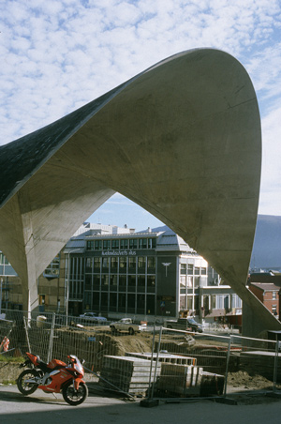


Shell Structures
Curved thin component
Thickness must be much smaller than radius of curvature
Used in roofs, walls, containers, …

Slide 17
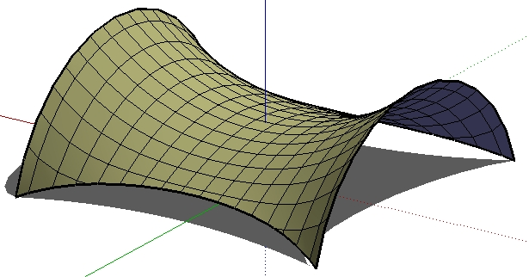

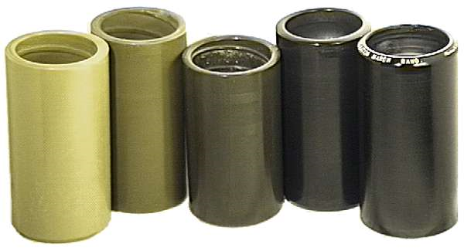
Shell Curvature
Defined by Gaussian curvature
K > 0
K = 0
K < 0

Slide 18
Governing Equation
Force per length depends on the radius of curvature
This is called membrane equation

Slide 19
Applications of Shell Equation
Spherical pressure vessels
Cylindrical pressure vessels

Slide 20
Example: Dented Coke Can

